Slide 1
SQL ANALYSIS REPORT
Adventure works
Data Analysis
Adventure works
Prepared by: Shiva Keshav | Role: Data Analysis | Tool: SQL |
Shiva keshav Thatipelly

Slide 2
Adventure Works Project: Business Questions
Q1. Overview
Q2. Which product categories generate the highest revenue and profit?
Q3. Which product subcategories have high sales but low profit margins?
Q4. How has monthly revenue changed over time and where are the major growth or decline periods?
Q5. Which territories contribute the most revenue and profit?
Q6. Who are the top 10 customers by lifetime value (LTV)?
Q7. What percentage of total revenue comes from the top 20% of customers?
Q8. Which customer segments generate the highest average order value?
Q9. Which products generate the highest profit, not just revenue?
Q10. Which products has low sales in the top category
Q11. Which territories show the highest revenue growth rate year-over-year?
Q12. Are there territories with high order volume but low profitability?
DATASE SUMMARY :
• Total Orders: 31,465 • Total Sales: 109.8M • Average Order Value: 3,491 • Total Products: 504 • Total Customers: 19,820 • Total Profit: 9.37M

Slide 3
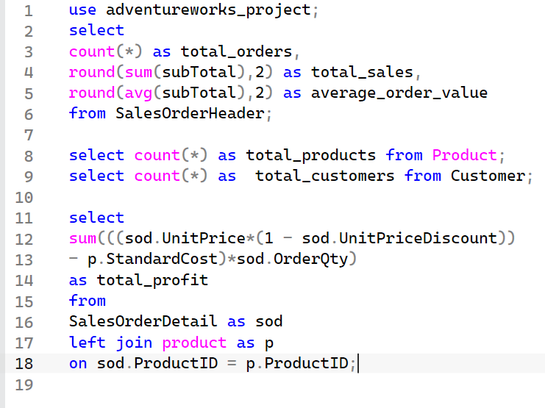
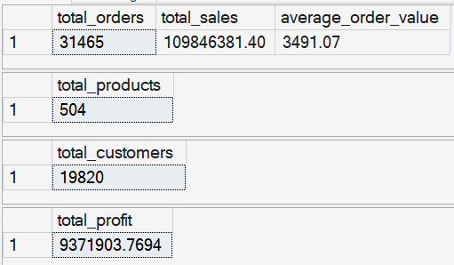
Q1 OVERVIEW OF THE DATA
DATASET SUMMARY :
• Total Orders: 31,465 • Total Sales: 109.8M • Average Order Value: 3,491 • Total Products: 504 • Total Customers: 19,820 • Total Profit: 9.37M

Slide 4
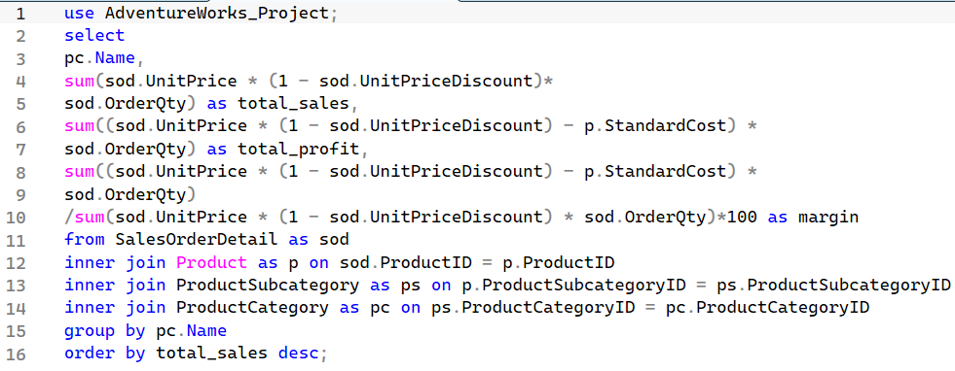
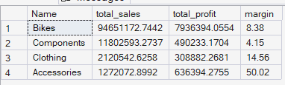
Q2 Which product categories generate the highest revenue and profit?
Observation :
1. Bikes had the highest sales (94.6M).
2. Bikes generated the highest profit (7.9M).
3. Accessories had the best profit margin (50%).
4. Clothing performed moderately in both sales and profit.

Slide 5
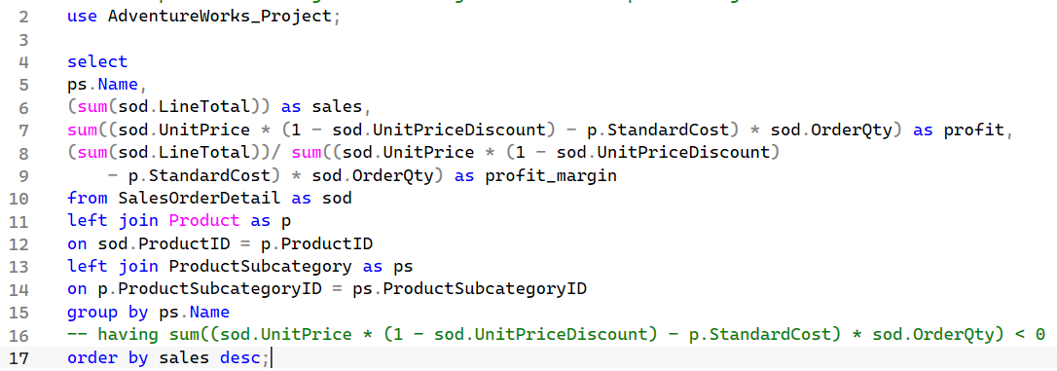
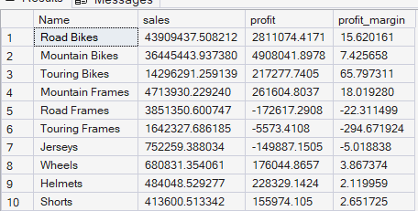
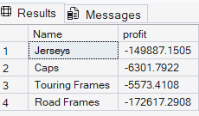
Q3 Which product subcategories have high sales but low profit margins?
Sub categories with negative profit

Slide 6
Q3 Which product subcategories have high sales but low profit margins?
KEY FINDINGS :
On The Analysis I observed That Road Bikes Have Highest Sales But Low Profit Margin (15%)
And I Also observed There is Good Profit Margin From Touring Bikes(65%)
We should Focus On :
Few products with Are No profit They Are In Negative
Jerseys (-149,887)
Caps (-6,301)
Touring Frames (-5573)
Road Frames (-172,617)

Slide 7
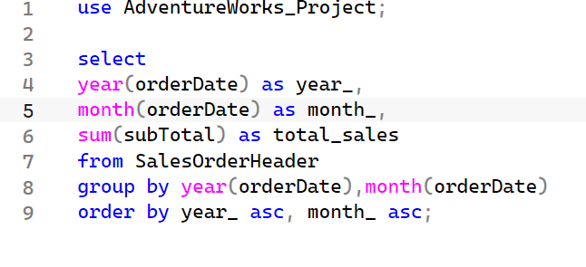
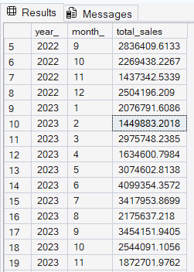
Q4 How has monthly revenue changed over time and where are the major growth or decline periods?
Note: This analysis on next Slide uses only 2023 and 2024 data. The years 2022 and 2025 were excluded because they do not contain data for all months.
Contd..

Slide 8
Q4 How has monthly revenue changed over time and where are the major growth or decline periods?
Observation :
Sales was low in February and April.
Sales increased steadily from May and reached a peak in June.
Strong sales performance was maintained during June and July.
Sales declined in August
Sales recovered and performed well in September and October.
Another drop was observed in November
Sales improved again in December
Overall, the highest sales were recorded in June, July, September, and October.

Slide 9
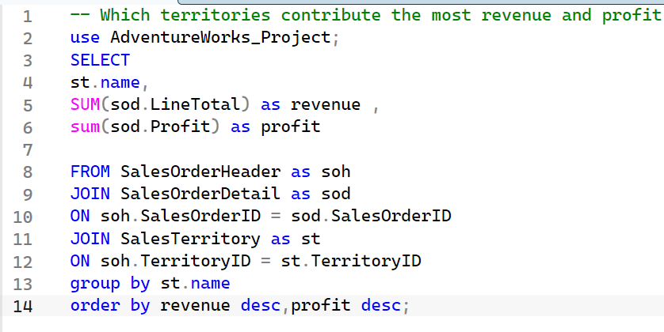
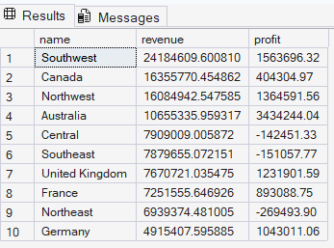
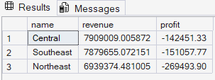
Q5 Which territories contribute the most revenue and profit?
KEY INSIGHTS :
Most revenue and profit generated by southwest with Revenue ($24.18M) and the highest profit ($1.56M)
On The Second Place We have Canada with Revenue ($16.35M) and the profit ($0.40M)
We should focus on :
1. There are Three Territories With negative Profit But This Territories have Good Revenue

Slide 10
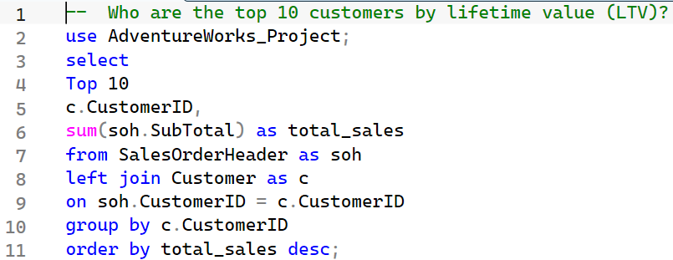
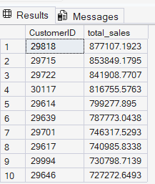
Q6 Who are the top 10 customers by lifetime value (LTV)?
Key Insights :
Customer ID 29818 is the top customer, generating $877K in total sales.
The top 3 customers each contributed more than $840K in sales.
All top 10 customers generated $727K in total sales.

Slide 11
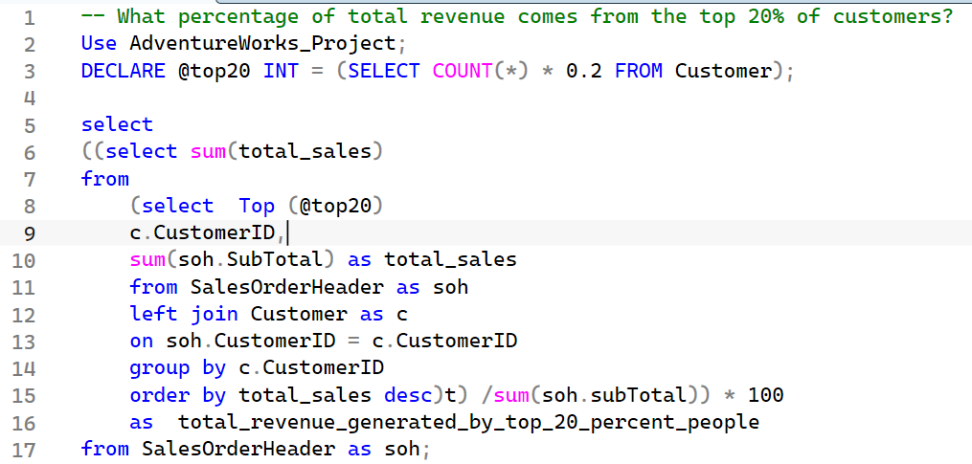

Q7 What percentage of total revenue comes from the top 20% of customers?
Key Insight :
On the Analysis I observed That 90 % Revenue Was generating by the Top 20 % people

Slide 12
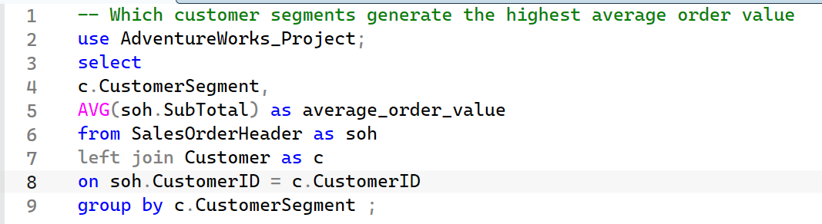

Q8 Which customer segments generate the highest average order value
Conclusion: Individual customers had an average order value of 3491.07. Store customers had no orders, so they were not included in the analysis.

Slide 13
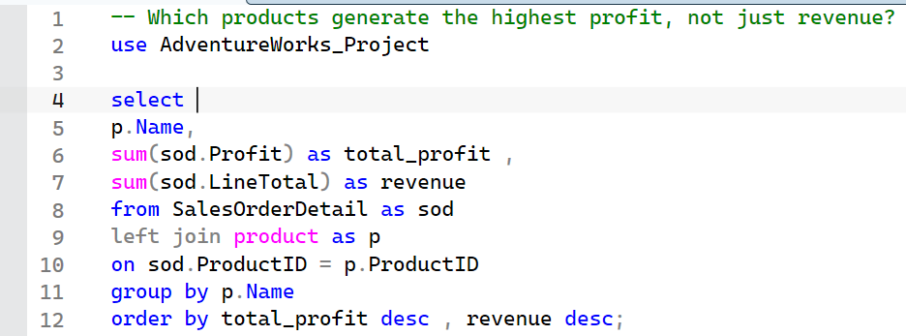
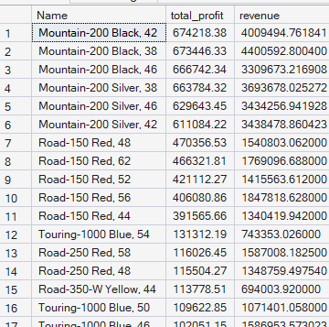
Q9 Which products generate the highest profit, not just revenue?
Key Insights
Mountain-200 Black,42 generated the highest total profit of 674,218.38, making it the most profitable product
On the Second Place We have Mountain-200 Black,38 With Total profit of 673,446.33

Slide 14
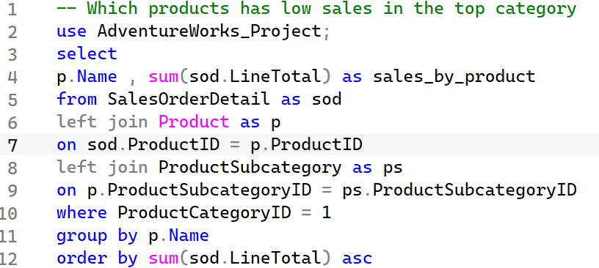
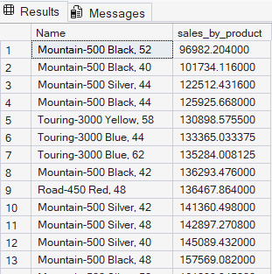
Q10 Which products has low sales in the top category
Conclusion: The Mountain-500 Black, 52 generated the lowest sales among all bike products. These low-selling products may need better marketing, discounts to Improve Sales

Slide 15
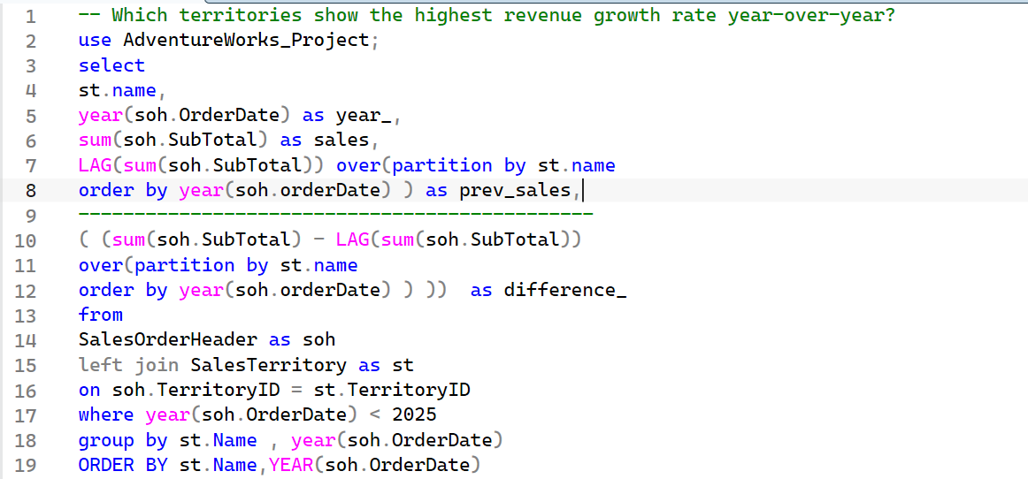
Q11 Which territories show the highest revenue growth rate year-over-year?
Contd..

Slide 16
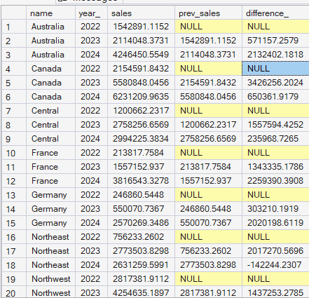
Q11 Which territories show the highest revenue growth rate year-over-year?
Observation:
Most territories showed good revenue growth year over year. Australia, Germany, the United Kingdom, Northwest, and France had good growth. However, Canada and Central showed a decrease in sales compared to the previous year. Northeast and Southeast also had negative growth, which means their sales went down. These territories need more attention to understand why sales decreased and how they can be improved.

Slide 17
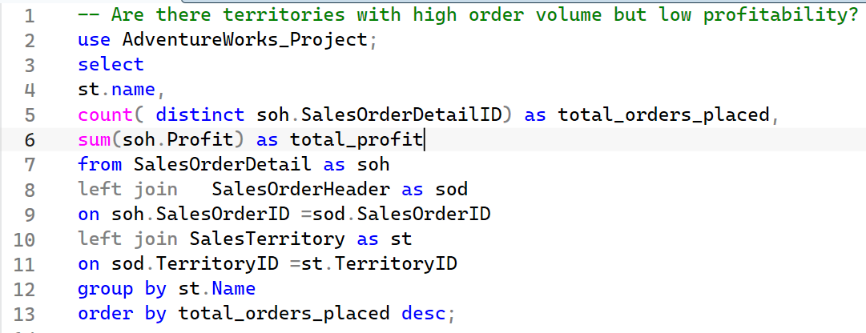
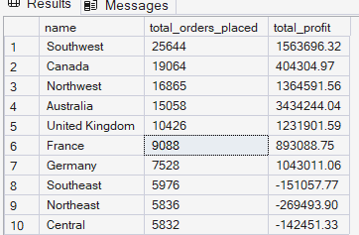
Q12 Are there territories with high order volume but low profitability?
Contd..

Slide 18
Q12 Are there territories with high order volume but low profitability?
Observation:
Southwest, Canada, and Northwest had the highest number of orders, but their profit was lower compared to Australia. Australia had fewer orders but generated the highest profit. The United Kingdom and France also showed good profit with fewer orders.
We should focus on :
Southeast, Northeast, and Central has negative profit. These territories We should focus

Slide 19
✓
Analysis Complete
This SQL documentation covers 12 Business Questions
12
Queries Analyzed
Shiva Keshav Data analyst

